Slide 1

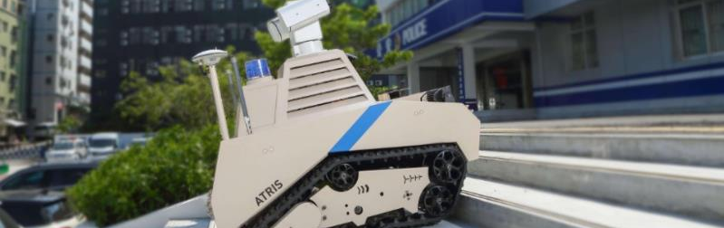
A Framework for De-Risking Custom Battery Integration in Autonomous Mobile Robots (AMRs)
A Large Power Technical White Paper
By Large Power Team
y
Power Differently
www.large-battery.com

Slide 2

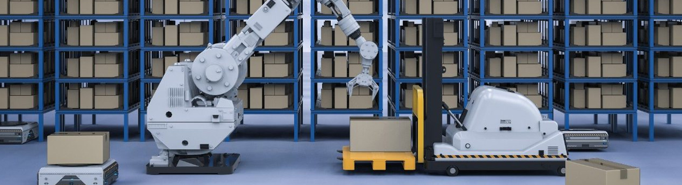
Executive Summary
$113B
Projected value of the global AMR market by 2033
Critical Integration: As AMRs become integral to warehousing, manufacturing, and logistics operations, their operational uptime and reliability are paramount.
Power Dependency: The battery system—the heart of every AMR—is the single most critical factor in achieving reliable operation.
Hidden Risks: Many engineering teams select power solutions based on a superficial review of supplier spec sheets, introducing significant risks that can lead to performance issues and costly project delays.
De-Risking Framework: This white paper presents a comprehensive engineering framework for de-risking custom battery pack selection and integration for AMR applications.
By shifting from component purchasers to strategic partners, engineering teams can ensure their power systems are robust, reliable, and optimized for real-world performance.
Power Differently
2

Slide 3
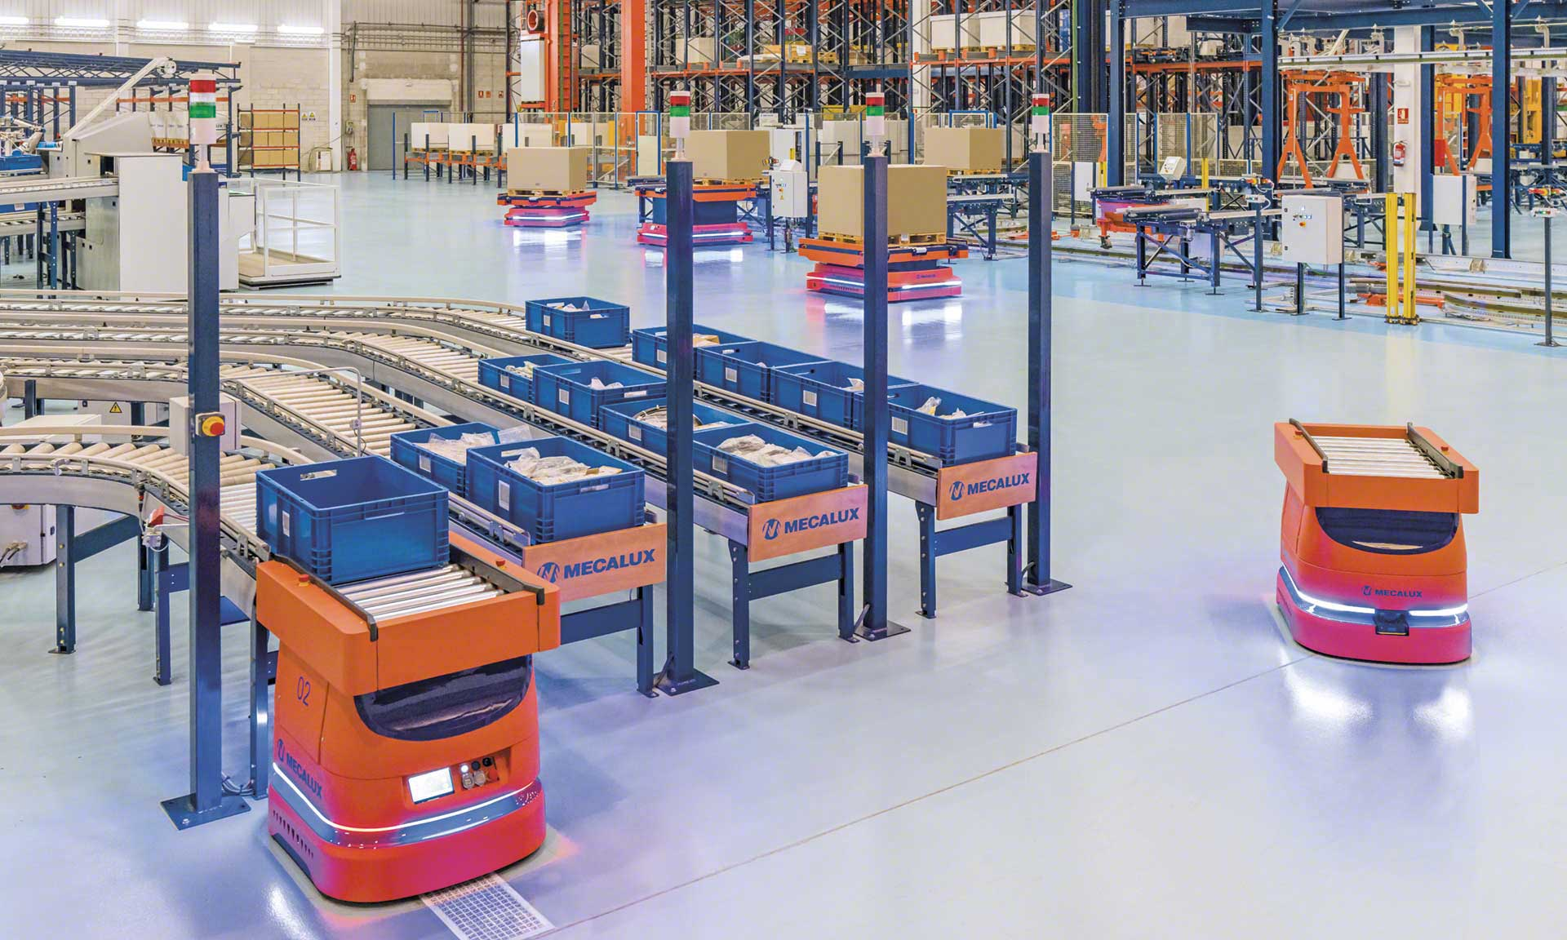
The Problem: Why Spec Sheets Are Not Enough
Relying solely on a battery supplier's spec sheet introduces significant risk to your AMR project. Standard datasheets represent performance under controlled laboratory conditions that rarely match the complex, dynamic realities of warehouse or manufacturing environments. This disconnect creates hidden problems that aren't visible until the robot is deployed in the field.
Lab Testing Conditions Real AMR Environment
Constant discharge rates
High current peaks and variable loads
Room temperature (20-25°C)
Wide temperature fluctuations (-20°C to 45°C+)
Simple charge/discharge cycles
Fast charging and opportunity charging
Controlled testing environment
Shock, vibration, and mechanical stress
Without application-specific testing, these hidden risks emerge only after
deployment – resulting in unexpected downtime, reduced run time, and safety concerns.
Power Differently
3

Slide 4

Hidden Dangers of Spec Sheet Engineering
Voltage Sag Under Peak Load
Nominal voltage may drop below robot's minimum threshold during high-power tasks like acceleration or lifting, causing unexpected shutdowns.
Rated Capacity vs. Real-World Usable Energy
Amp-hour ratings from lab conditions rarely match AMR's dynamic duty cycles, resulting in 20-30% less runtime than expected.
3 Cycle Life Illusion
High-current demands and rapid charging significantly reduce actual cycle count from advertised numbers, impacting TCO and maintenance schedules.
1
2
4 Thermal Management Blind Spots
Spec sheets don't reveal critical thermal design issues that can create cell hot spots, degrading performance and potentially creating safety risks.
5
Environmental Extremes
Standard batteries aren't designed for warehouse/cold storage conditions, causing performance failures at high temperatures and charging issues below freezing.
6
"One-Size-Fits-All" BMS Fallacy
Generic BMS settings cause either unnecessary shutdowns during normal operations or insufficient protection for AMR-specific fault conditions.
Power Differently

Slide 5
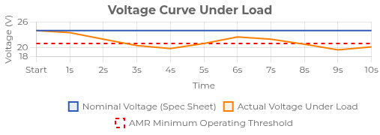
Voltage Sag and Power Interruptions
A battery spec sheet lists a nominal voltage (e.g., 24V or 48V), but this figure is static. In real-world AMR operations, voltage behaves dynamically and can significantly drop under load.
When Voltage Sag Occurs
During high-current events (AMR acceleration) When lifting or moving heavy payloads Navigating inclines or rough terrain
In cold operating environments
Impact on AMR Operations
If voltage sag is too severe, the voltage can fall below the AMR's minimum operating threshold, causing the robot's control system to register a fault and shut down unexpectedly.
Critical Fact:
⚠ This dynamic behavior is never detailed on a standard spec sheet, yet it's a common cause of unexplained field failures and operational disruptions.
Power Differently

Slide 6
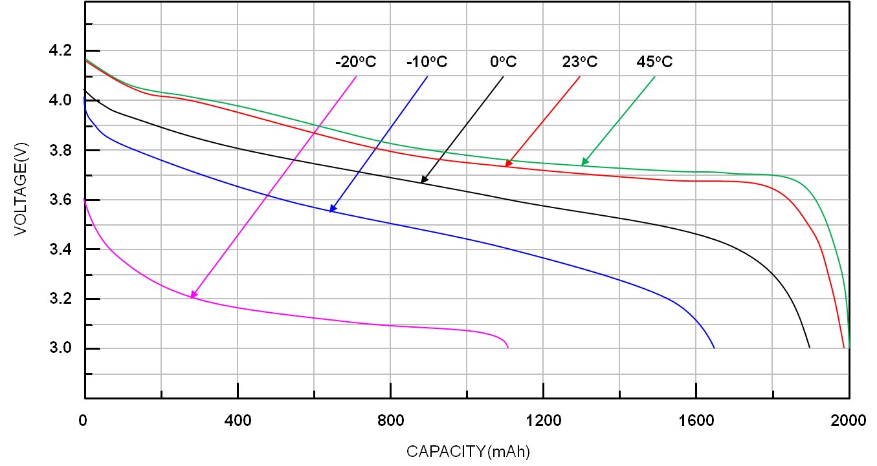


Spec Sheet Capacity vs. Real-World Runtime
Amp-hour (Ah) capacity ratings on spec sheets are measured under ideal laboratory conditions, typically at a low, constant discharge rate (0.2C). However, an AMR's duty cycle is far more demanding:
L
Lab Test Conditions:
Constant low-rate discharge at room temperature, resulting in optimistic capacity ratings that rarely reflect real operating conditions.
R
Real-World AMR Usage:
Variable load with high-current peaks for acceleration and lifting, combined with temperature fluctuations, reducing usable capacity by 20-30%.
Practical Impact:
An engineer designing for an 8-hour shift based on a 60Ah spec sheet rating may find the AMR only runs for 6 hours in actual operation, severely impacting productivity and operational uptime.
Power Differently

Slide 7
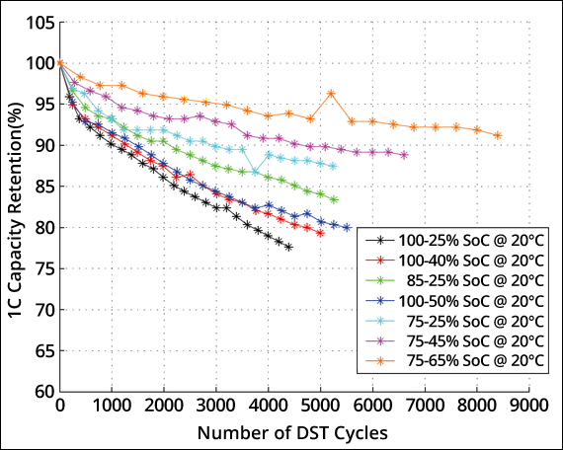
Cycle Life & Energy Density Imperatives
On the Spec Sheet:
3,000+ cycles under ideal lab conditions
Low current draw (0.2C-0.5C)
Room temperature (25°C) Shallow discharge cycles
In Real AMR Usage:
Fraction of rated cycles High peak currents (1C-3C+) Variable temperatures
Deep discharge + rapid charging
The Cycle Life Illusion: High current demands for acceleration and lifting combined with rapid charging significantly accelerates capacity fade. A battery rated for 3,000 cycles may deliver only a fraction in real logistics applications.
Unexpected Costs: Shortened operational lifespan leads to frequent battery replacements and higher Total Cost of Ownership (TCO) than projected.
Energy Density Solution: Higher energy density batteries provide longer runtime without increasing robot size/weight. Fewer charge cycles are required over time, directly extending the battery's service life.
Power Differently

Slide 8
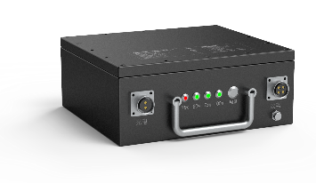

Thermal Management and Environmental Risks
Standard battery spec sheets provide only basic temperature ranges but fail to reveal how the pack's internal design manages heat during critical operations like rapid charging or high-current discharging. AMRs operate in diverse environments—conditions that dramatically affect battery performance and safety.
Spec Sheet Shows:
Operating temperature range: -10°C to 45°C
Reality Includes:
Internal cell temperatures up to 20°C higher than ambient during peak loads
Critical Thermal Management Risks:
1
Hotspot Formation: Inefficient thermal design creates cell temperature imbalances, accelerating degradation in specific areas and reducing pack longevity.
2
Cold Environment Failure: At temperatures below 0°C, standard batteries experience severe capacity reduction and may become unable to accept a charge at all.
3
Safety Hazards: In extreme cases, thermal runaway can occur if heat buildup isn't properly managed, especially during fast charging or high
current operations.
8
Power Differently

Slide 9
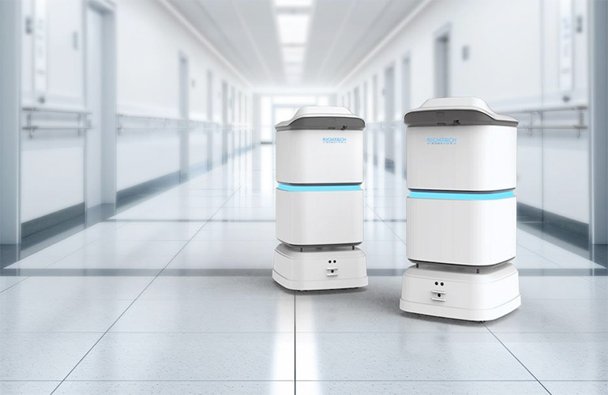
2
Framework
The De-Risking Engineering Framework
To mitigate the risks of spec sheet engineering, a rigorous, data-driven validation process is required. This framework moves beyond trusting the spec sheet to verifying performance under conditions that replicate the AMR's real-world application.
Step 1: Duty Cycle Profiling & Load Simulation Creating and validating the AMR's unique power consumption fingerprint.
Step 2: Application-Specific Thermal Analysis Ensuring thermal stability for safety and longevity in real-world conditions.
Step 3: BMS Customization and Fault Injection Tailoring the battery management system to the AMR's specific requirements.
Step 4: Real-World Cycle Life Testing
Validating true operational lifespan under application-specific conditions.

Slide 10
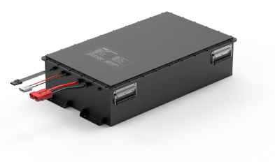
Step 1: Duty Cycle Profiling & Load Simulation
The foundation of a reliable power system is a deep understanding of the energy it must deliver. A duty cycle profile serves as the fingerprint of your AMR's power requirement.
1
Instrument Prototype
Capture real-world current draw data across all operational scenarios: acceleration from standstill, carrying maximum payload, navigating inclines,
idle states, and braking.
2
Create Comprehensive Profile
Analyze data to identify peak current duration, average energy consumption, and regenerative charging potential. This moves beyond
simplistic spec sheet analysis to real-world demands.
3
Validation Testing
Program a battery cycler/tester with the duty cycle profile. Test prospective
battery packs to verify voltage remains above the AMR's cutoff threshold during all peak current events.
Why This Matters:
This data-driven approach identifies potential voltage sag issues that would
cause unexpected shutdowns in the field, before they impact your operations. It enables true optimization of the battery system for your specific application.
Power Differently

Slide 11
Step 2: Application-Specific Thermal Analysis
Ensuring thermal stability is critical for both safety and longevity, especially with fast-charging and high-utilization AMRs. Comprehensive thermal analysis validates cooling design under your specific load conditions.
1
Thermal Imaging During Load Simulation
Deploy thermal cameras to monitor the pack's surface temperature distribution during simulated AMR duty cycles, identifying potential hot spots that could lead to premature cell aging or thermal events.
2
Strategic Thermocouple Placement
Position thermocouples between cells and at critical points to measure internal temperature gradients. Test at the highest anticipated ambient operating temperature (e.g., non-climate-controlled warehouse in summer).
3
Validation of Cooling Systems
Evaluate the effectiveness of the pack's thermal management design— including cell spacing, heat sinks, and enclosure ventilation. For AMRs operating in cold environments, validate the performance of built-in battery heating systems.
This analysis ensures the battery design can maintain safe operating temperatures during peak load periods, maximizing both performance and cycle life while preventing thermal runaway conditions.
Power Differently

Slide 12
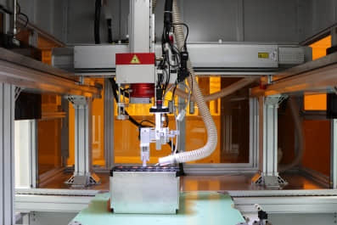

Step 3: BMS Customization & Fault Injection
The Battery Management System (BMS) must be treated as a configurable safety and performance system, not a black box. Off-the-shelf battery packs typically use a generic BMS with pre-programmed safety limits that are not optimized for an AMR's specific load profile.
Custom Firmware Configuration
Work with your battery partner to customize BMS firmware parameters to match your AMR's validated duty cycle profile. Parameters include over- current protection (peak and sustained), over-voltage, and under-voltage cutoffs.
Fault Injection Testing
Once configured, the BMS must undergo fault injection testing to verify protection circuitry functions correctly. This ensures the battery can deliver necessary peak power while still providing robust protection.
Short-Circuit Tests
Verifies BMS protection against external
shorts
Over-Temperature Tests
Validates thermal protection systems
Over-Voltage Tests
Ensures charging safety mechanisms
Current-Limiting Tests
Confirms protection during high-load events
Engineering Benefit: A customized BMS provides intelligent protection tailored to your application, ensuring the battery can handle peak power demands without false faults while maintaining safety under genuine fault conditions.
Power Differently
12

Slide 13

Step 4: Real-World Cycle Life Testing
A battery's cycle life rating on a spec sheet is among the most misleading metrics. Without contextual application testing, it cannot reliably predict actual operational lifespan in your AMR. Large Power conducts application-specific validation to ensure accurate performance projections.
Validation Process:
Using the application-specific duty cycle profile, we continuously cycle the battery pack from full charge to the designed end-of-discharge point. This test is run for hundreds of cycles, simulating months of operation to extrapolate the true operational lifespan under your AMR's unique conditions.
Performance Metric
Spec Sheet Claim
AMR Field Reality
Business Impact
Cycle Life (to 80% capacity) | 3,000 cycles | 800-1,200 cycles | Higher replacement frequency, increased TCO
Capacity Degradation | Linear, predictable | Non-linear, accelerates after 500 cycles | Unpredictable runtime, operational disruptions
Voltage Stability | Consistent throughout discharge | Degrading stability after 60% DoD | Increased risk of unexpected shutdowns
Fast-Charge Impact | Minimal (not specified) | Reduces cycle life by 25-40% | Forced tradeoff: uptime vs. battery longevity
Performance at Temperature Extremes | Stated range: -20°C to 60°C | Significant degradation at extremes | Reduced reliability in cold storage/hot environments
Power Differently

Slide 14

Selecting an Engineering Partner, Not a Component Supplier
Successfully implementing the validation framework requires a battery provider with deep engineering expertise. The goal is to find a partner who collaborates on de-risking the power system, not a supplier who simply ships a product.
Capability
Engineering Partner
Component Supplier
Engineering Approach | Collaborative design process focused on application-specific optimization | Generic solutions with limited customization options
Technical Support | In-house electrical, mechanical, and firmware engineers work directly with your team | Basic support with limited technical depth
Testing Capabilities | Comprehensive in-house testing lab for load simulation and cycle life testing | Limited to standard tests; relies on third parties
Certification | Extensive experience managing certification (UN38.3, UL, IEC) | Customer typically responsible for certification
Supply Chain | Full supply chain visibility and component lifecycle management | Limited visibility beyond immediate inventory
Key Capabilities of an Ideal Engineering Partner:
Vertically Integrated Expertise
In-house electrical, mechanical, and firmware engineers for application- specific design
Testing & Certification
In-house testing lab and experience with certification processes (UN38.3, UL, IEC)
Quality & Supply Chain
ISO 9001-certified with supply chain management from cell sourcing to lifecycle
Power Differently

Slide 15
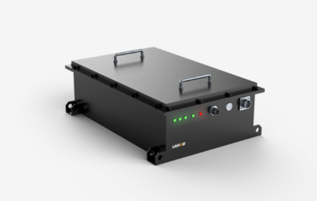
Case Study: Hospital Logistics AMR Battery Solution
Challenge: A leading developer of hospital logistics AMRs faced reliability issues with power systems in 24/7 environments, experiencing inconsistent performance and premature battery degradation.
Customized Solutions:
1
Optimized Cell Selection & Matching
High-power 28650 cells with proprietary matching protocol ensuring
consistent performance
2
Application-Specific Design
Impact-resistant shell with gold-plated contacts for busy hospital
environments
3
Operational Uptime Focus
Quick-swap battery mechanism allowing AMRs to return to service in seconds
Measurable Results:
10%
Max runtime variation over service life
Seconds
Battery swap time vs. hours charging
24/7
Reliable operation in healthcare

Slide 16
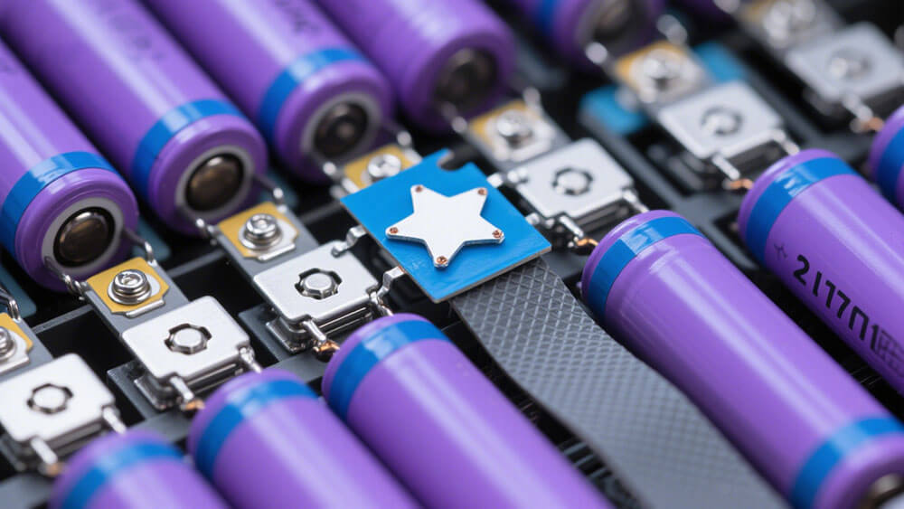
Conclusion & Contact
Flawless AMR battery reliability is not delivered by spec sheet metrics, but through partnership with an engineering-led custom battery supplier.
Large Power offers a unique combination of technical expertise, specialized design capabilities, and mission-critical reliability that transforms your AMR's power system from a commodity component to a strategic advantage.
Ready to de-risk your AMR power system?
Email:
@
market@large-battery.com
Website:
www.large-battery.com
Schedule Engineering Consultation
Power Differently

