Slide 1


Custom Battery Pack Technical Engineering Guide
Delivering Performance Since 2002
By Large Power Team
Power Differently
www.large-battery.com

Slide 2

Table of Contents
Introduction
Section 1: The Anatomy of a Custom Battery Pack
  Understanding Battery Packs
  The Role of Smart Battery Packs
  Why Advanced Lithium Chemistry is the Standard
Section 2: The Custom Design & Development Process
  Our Collaborative Development Stages
  Key Design Parameters: Your Specification Checklist
  Typical Development Timeline
Section 3: Core Technologies and Components
  Battery Chemistry and Cell Technology
  Battery Management Systems (BMS)
  Protection Circuit Modules (PCM)
  Fuel Gauges and State of Charge
  Advanced GPIO Options
Section 4: Power System and Charging Design
  Integrated System Output Power
  Battery Charging Methodologies
Section 5: Mechanical and Environmental Design
  Enclosure and Mechanical Specifications
  Intrinsically Safe & Explosion-Proof Designs
Section 6: Regulatory Compliance and Logistics
  Navigating Global Certifications (UL, IEC, CE)
  UN 38.3 Transportation Testing
  Shipping and Transportation Logistics
Section 7: Partnering with Large Power
  Why Partner with Large Power?
  Request Design Support
Appendix: Glossary of Terms
Power Differently

Slide 3

Introduction: About Large Power
Large Power is a high-tech enterprise founded in 2002, specializing in tailor-made lithium battery systems and solutions for a global client base. From our headquarters in the Greater Bay Area of China, we have dedicated over two decades to pushing the boundaries of battery technology for the world's most demanding applications.
Our mission is to serve as a deeply integrated partner for engineers and product designers who require more than off-the-shelf solutions. With a state-of-the-art 15,000m² manufacturing facility and a dedicated team of over 280 professionals—including more than 70 R&D engineers—we have the scale and expertise to bring complex battery concepts to life.
We have successfully delivered over 9,000 unique custom battery solutions for industries where performance and reliability are non-negotiable, including defense, aerospace, medical devices, robotics, and industrial equipment.
At Large Power, we provide a true "one-stop" customization service. Our engineering teams collaborate with you on every aspect of the project, from initial concept and industrial design to the development of proprietary software and electronics.
Power Differently

Slide 4




'Four Highs and Two Low’s Framework
Large Power's engineering philosophy is built on a foundation of technology-driven innovation and integrated R&D. We focus on developing solutions for specialized, high-demand applications, ensuring unmatched performance under extreme conditions. Our core technological strengths are defined by our "Four Highs and Two Lows" framework:
1
High Energy Density
To maximize runtime and performance.
2 High-Rate Discharge
For applications requiring significant power on demand.
3
High-Temperature Resistance
Ensuring operational integrity in extreme heat.
4 High Safety
Utilizing advanced chemistries like quasi-solid-state for ultimate reliability.
5
Low-Temperature Discharge and Charge Performance
Guaranteeing functionality in extreme cold.
4 High
2 Lows
Large Research Institute of Lithium-Ion Battery Engineering
Power Differently

Slide 5


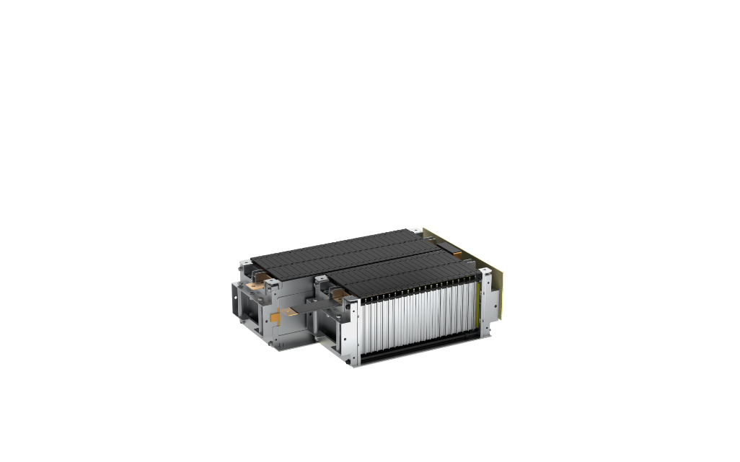

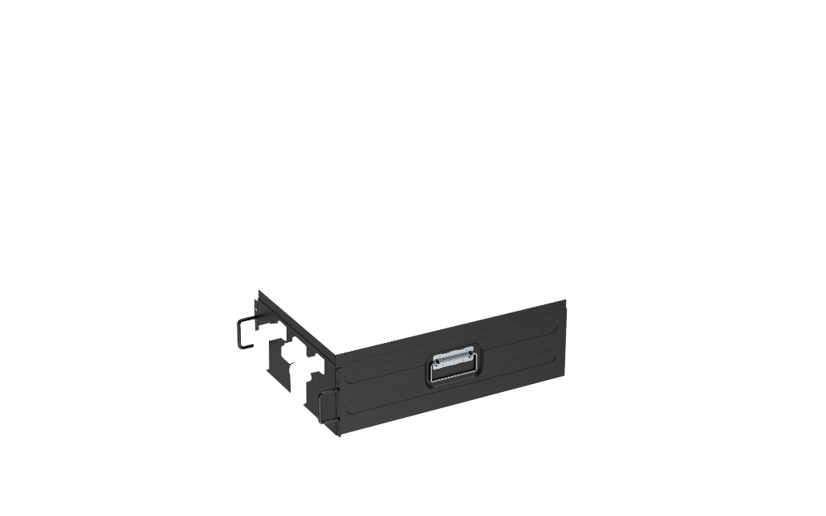


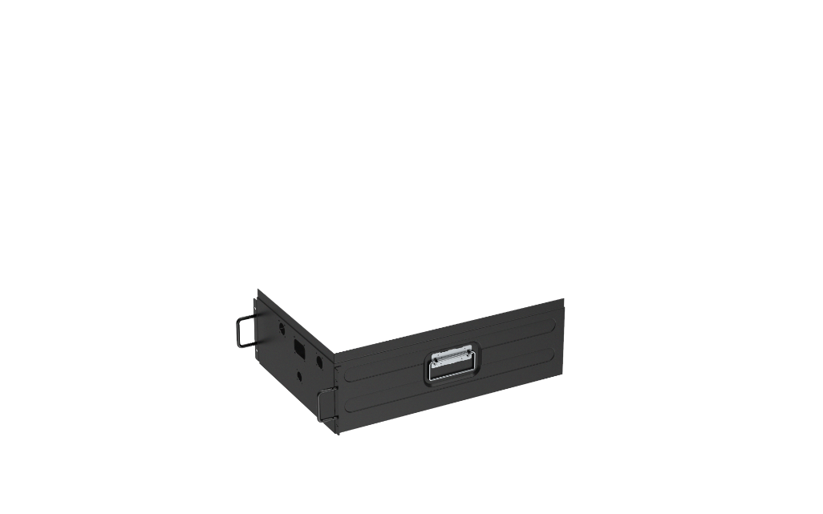
Section 1
1
The Anatomy of a Custom Battery Pack
Battery packs are the power source for any portable or remote device. The fundamental building block of a battery is the cell, which has a fixed voltage defined by its chemistry. While cell voltage is relatively constant within a chemistry family, capacity varies with the physical size of the cell.
  Understanding Battery Packs
Exploring how voltage, capacity, and configuration determine a battery's capabilities.
  The Role of Smart Battery Packs
Intelligent subsystems with advanced BMS features for optimization and safety.
  Why Advanced Lithium Chemistry is the Standard
Superior performance capabilities for demanding applications.
Tailor-made BMS/Power Supplies
Tailor-Made Structural Design
Tailor-Made Battery Cells
Selection of Connectors
Power Differently

Slide 6
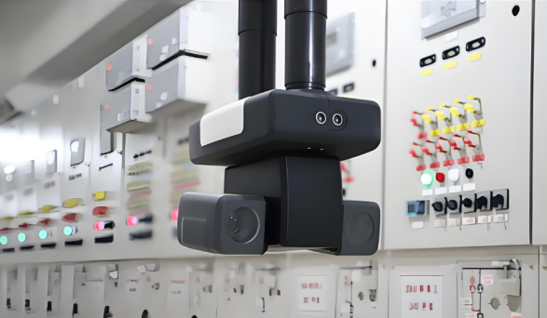

1.1 Understanding Battery Packs (Part 1)
Battery packs are the power source for any portable or remote device. The fundamental building block of a battery is the cell, which has a fixed voltage defined by its chemistry. While cell voltage is relatively constant within a chemistry family, capacity varies with the physical size of the cell.
Power Differently

Slide 7

1.1 Understanding Battery Packs (Part 2)
To meet your application's power requirements, a custom battery pack is designed by combining cells to achieve the necessary voltage and capacity. The final design is determined by the device's needs: its operating voltage, load current, required runtime, and recharge time, as well as environmental conditions, physical space constraints, weight limitations, and regulatory mandates. The number, size, and configuration of the cells define the pack's final form factor and weight.
Operating & System Requirements: Your system must be designed to handle the voltage window fluctuation. If your system needs to operate while charging, it must also accept the charging voltage, which is always higher than the battery's fully charged voltage.
Environmental Considerations: The pack design must account for your specific operating environment, temperature ranges, and exposure conditions. A battery's effective capacity decreases at higher discharge rates or lower temperatures.
Physical Constraints: Space limitations, weight requirements, and form factor all influence the final pack design. The enclosure and connections must be suitable for the intended application while maintaining optimal performance.
Power Differently

Slide 8
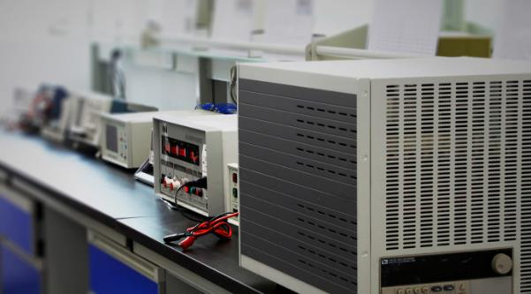
Voltage/Capacity & C-Rate Calculations
Voltage Window Understanding
The voltage of a cell fluctuates with its state of charge. For example, a 3.7V nominal lithium- ion cell may operate from 4.2V when fully charged down to 3.0V when discharged. Your system must be designed to handle this voltage window. Alternatively, Large Power can engineer and embed an output voltage regulator into the battery pack to provide a constant, stable voltage to your device.
Amp-Hour Capacity Ratings
Cell capacity is rated in amp-hours (Ah) or milliamp-hours (mAh). This value, often denoted as C, represents current multiplied by time (It). For instance, a 5Ah battery is equivalent to a 5,000mAh battery. If you need to discharge it over 10 hours, you can draw a current of 0.5A (5Ah/10h). If your device draws 100mA, it can run for 50 hours (5000mAh/100mA).
C-Rate & Discharge Performance
Discharge and charge rates are often expressed in terms of C. A discharge rate of C/5 means the battery is discharged at a constant current over 5 hours. However, this is an estimate. A battery's effective capacity decreases at higher discharge rates or lower temperatures. A battery's rated capacity is typically specified at a low C/20 discharge rate at room temperature. If you discharge that same battery at a much higher rate, its usable capacity will be lower due to internal impedance and chemical losses.
Power Differently

Slide 9
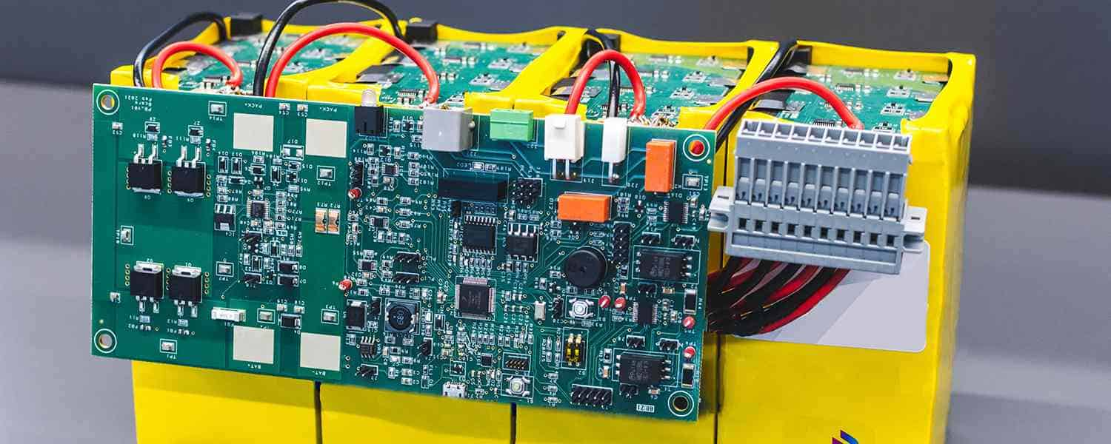
1.2 The Role of Smart Battery Packs
A smart battery pack is more than just a power source; it is an intelligent subsystem that communicates with the host device to optimize performance, safety, and user experience. It can manage its own charging, report its status, predict remaining runtime, provide real-time temperature, voltage, and current data, and continuously self-correct to maintain accuracy.
Large Power specializes in designing smart battery packs that incorporate our proprietary Battery Management Systems (BMS). These systems integrate advanced features like high- accuracy fuel gauging, cell balancing, multi-layered protection circuitry, and sophisticated communication protocols (I2C, SMBus, CANBUS, RS485).
As devices become smaller and lighter, custom lithium batteries offer the advantages of high energy density, low weight, and a wide operating temperature range. The true 'smart' functionality comes from the firmware and software embedded within the BMS. Large Power's in-house engineering team develops custom firmware to precisely match the performance and safety requirements of your device.
Power Differently

Slide 10
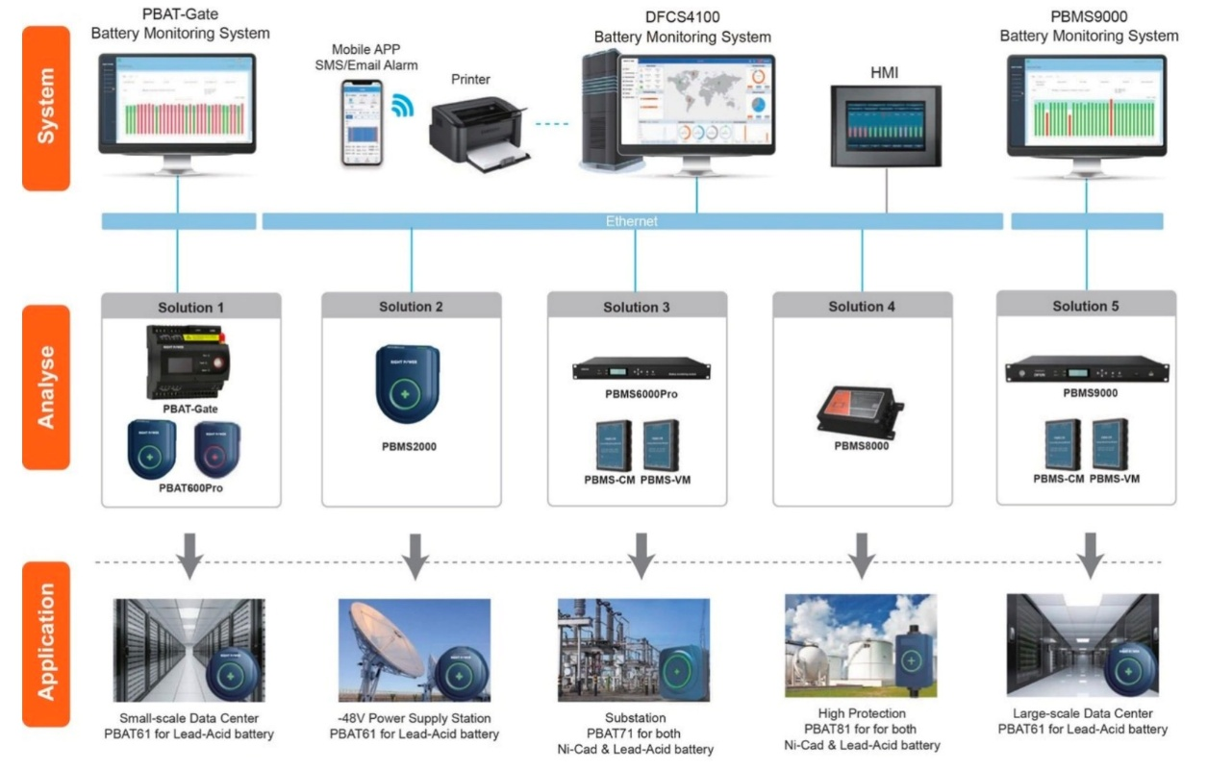
1.2 Smart Battery Packs – Features & Firmware
Key Smart Battery Features:
Cell balancing to extend overall cycle life and prevent individual cell stress
Precise State of Charge (SOC) and State of Health (SOH) determination
Intelligent charge control with sophisticated algorithms
History logging and performance data tracking
Authentication and serialization for traceability
Our smart battery packs can be viewed as complete power systems. The embedded electronics enhance safety, reliability, and cycle life while giving end-product system engineers more options to create a reliable and user-friendly device. Features include preventing charging in extreme temperatures, data encryption, backup power management, and status monitoring.
Power Differently

Slide 11

1.3 Why Advanced Lithium Chemistry is the Standard
For modern, high-performance applications, the question is not whether to use lithium chemistry, but which lithium chemistry is the right fit. While legacy technologies like Nickel- Metal Hydride (NiMH) may be suitable for some low-cost, low-performance consumer products, they cannot meet the demands of the advanced systems Large Power specializes in.
Custom rechargeable battery packs using lithium cells (Lithium-Ion, Lithium-Polymer, LiFePO4) provide superior voltage and capacity, resulting in an exceptionally high energy density. Applications in fields like medical devices, military equipment, electric vehicles, and robotics demand a level of performance that only lithium chemistry can deliver.
The Large Power Advantage in Lithium:
Large Power focuses exclusively on advanced lithium solutions because today's engineering challenges require the highest energy density, lightest weight, and most reliable performance.
Energy Density: Lithium batteries offer significantly higher energy density than NiMH, allowing for smaller, lighter products or longer runtimes in the same form factor.
Performance: Lithium chemistries offer wider operating temperature ranges, higher discharge rates, and lower self-discharge rates, making them ideal for critical applications and extreme environments.
No Memory Effect: Unlike NiMH, lithium batteries do not suffer from the "memory effect" and do not require periodic full discharge cycles to maintain their health.
Cost and Complexity Mitigation: While lithium technology is inherently more complex, Large Power's 20+ years of specialization, in-house BMS development, and integrated manufacturing capabilities allow us to engineer cost-effective, highly reliable lithium solutions that mitigate the risks and complexities for our clients.
Power Differently

Slide 12
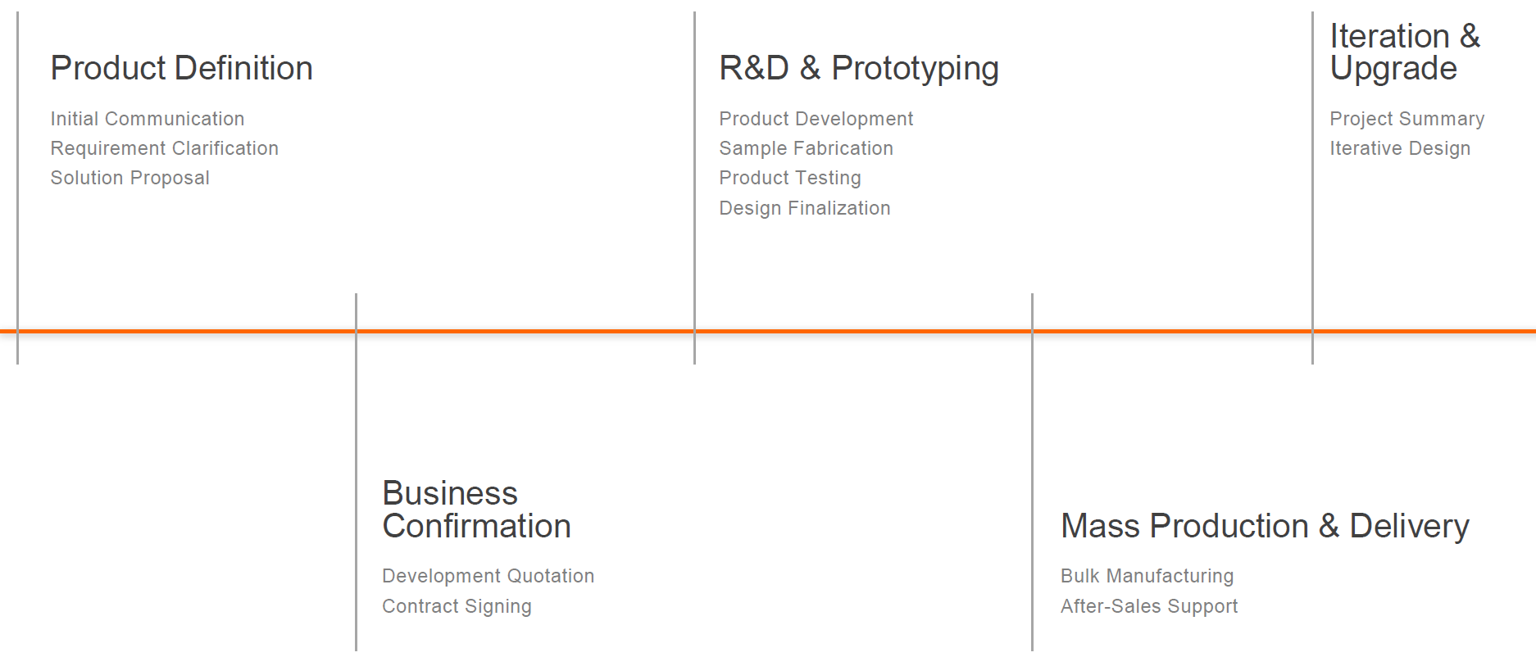
2
Section 2
The Custom Design & Development Process
The journey to a production-ready custom battery pack involves several key stages. Large Power's client-centric process is designed to ensure clarity, efficiency, and a final product that meets every specification. Our development approach minimizes scope creep and accelerates time-to- market.
  Our Collaborative Development Stages
From concept to certification, our three-stage process delivers precision and reliability.
  Key Design Parameters: Your Specification Checklist
Comprehensive electrical, mechanical, environmental, and system requirements for success.
  Typical Development Timeline
From scope refinement to certification and production - a detailed project roadmap.
Power Differently

Slide 13

  Collaborative Development Stages
Conceptual Development & Scope Refinement
This early stage begins when a customer has a clear idea of what their battery needs to do but requires engineering expertise to define the path forward. Our technical teams work closely with you to understand the application's requirements and create a detailed scope of work.
The primary challenge at this stage is "scope creep," where changing requirements can extend timelines and increase costs. To mitigate this, we help you finalize critical parameters upfront:
    Development budget - Setting clear financial boundaries
    Time-to-market deadline - Establishing realistic project timelines
    Target production piece price - Aligning design choices with commercial goals
Power Differently

Slide 14
2.1 Design & Build for Certification
Stage 2: Established Specification Battery Pack Design
This stage is for clients who have already invested significant time in defining the specifics of their application and can provide a detailed specification outline. This clarity dramatically reduces the development timeline and provides a clear path to production. The process moves directly to our team developing all drawings, schematics, software, firmware, and BMS designs.
Development Considerations
Hardware Development: Selection of optimal cell chemistry, connectors, design of the BMS (PCB, protection circuits, communication interface), design of structural and charging technology
Software Development: Configuration of host interface parameters (CAN, SMBus, I2C, etc.) and algorithms for safety and charging
Mechanical Development: Design of custom enclosures (PVC housings, plastic housings, metal housings) and connectors
Quality & Certification
Certification Management: Management of UL, CE, CB,IEC, UN 38.3, and other required certifications
Quality Management: Adherence to our ISO 9001:2015 and ISO 13485:2016 standards
Proven New Product Introduction (NPI) process
Testing and Programming: Design of all fixtures and programs needed to fully test each battery pack in- house
Stage 3: Battery Pack Design/Build for Certification
At this stage, the customer has a well-defined electrical and mechanical concept, perhaps even a preliminary drawing. This allows us to move very quickly through the final design, certification, and into production, significantly reducing development costs.
Common scenarios include adding protection circuitry or a standard BMS to an existing design, managing the entire certification process for IEC, UL, or UN 38.3, upgrading an existing product with new battery technology, and managing all shipping logistics and certifications for lithium batteries.
Power Differently

Slide 15
2.2 Key Design Parameters: Your Specification Checklist
A successful custom battery pack project begins with a comprehensive and well-defined set of requirements. Our engineers will collaborate with you to define these critical parameters.
Electrical & Performance Requirements
Nominal Voltage (V) | The target operating voltage for your device.
Nominal Capacity (Ah/mAh) | The required energy storage to meet your application's runtime needs.
Charging Voltage (V) | The maximum voltage the pack will be charged to.
Discharge Cut-off Voltage (V) | The minimum voltage before the device shuts down.
Standard & Max Charge Current (A) | The typical and peak currents for charging the battery.
Standard & Max Discharge Current (A) | The continuous and maximum current your device will draw.
Peak Current & Duration (A, sec) | Any momentary high-current pulses required.
Cycle Life Requirement | Number of cycles while maintaining capacity (e.g., >80%).
Mechanical & Physical Requirements
Environmental Requirements
Maximum Dimensions | Maximum space available for the battery pack.
Maximum Weight | The weight limit for the battery pack.
Enclosure Requirements | Material, manufacturing process, and color.
Connector Specifications | Model and type of required connector.
Charging Temperature Range | Ambient temperature range for charging.
Discharging Temperature Range | Ambient temperature range for operation.
Application Environment | Operating environment description (indoor, outdoor, etc.).
System & Commercial Requirements
Communication Protocol | Required communication method (I2C, SMBus, CAN, RS485).
Safety Certifications | Required certifications (UL, IEC, CE, CB, UN 38.3, etc.).
Project Phase | Current stage of your project (concept, prototype, production).
Sample Requirements | Prototype quantity and expected delivery timeline.
Power Differently

Slide 16

2.3 Typical Development Timeline
Even experienced engineers may encounter unforeseen challenges when specifying a battery. The most common cause of delay is "scope creep"—when specifications change mid- development. Because development can take up to 14 weeks, followed by another 16-20 weeks for certifications, it is critical to establish a solid specification from the start.
Typical Project Flow:
1
Scope Refinement 1-2 Weeks
2
Application Development 2-4 Weeks
3
Development Review 1 Week
4
Prototypes 4-6 Weeks
5
Regulatory Certification (if Lithium) 3-20 Weeks
6
Production
Avoiding Scope Creep
Large Power works with clients to ensure the design utilizes available technologies and components to accelerate projects from concept to production. Establishing solid specifications from the start is critical to preventing delays and maintaining project timelines.
Power Differently

Slide 17
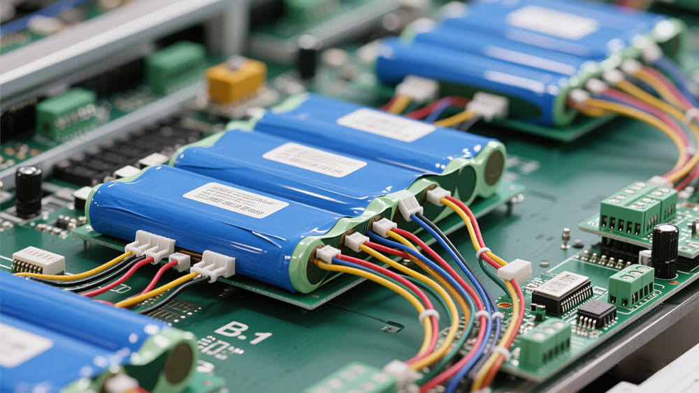
3
Section 3
Core Technologies and Components
Modern battery performance is defined by chemistry. While older technologies like NiMH output a nominal 1.25V per cell, lithium-ion rechargeable batteries output 3.2V to 3.7V per cell, enabling far greater power in a smaller package. Performance varies significantly between cells of the same chemistry from different manufacturers.
  Battery Chemistry and Cell Technology
Comparison of lithium chemistries with specialized high-performance cells.
  Battery Management Systems (BMS)
The brain of modern battery packs for protection, longevity, and readiness.
3.3-3.5 Advanced Components
Protection Circuit Modules, Fuel Gauges, and GPIO options.
Power Differently

Slide 18
3.1 Battery Chemistry and Cell Technology
Modern battery performance is defined by chemistry. While older technologies like NiMH output a nominal 1.25V per cell, lithium-ion rechargeable batteries output 3.2V to 3.7V per cell, enabling far greater power in a smaller package. Large Power partners with clients to understand application demands and select the optimal cell technology.
Specifications
NCM/NCA
LCO
LiFePO4 (LFP)
Specific Energy Density (Wh/kg) | 160-270 | 180-230 | 100-180
Nominal Cell Voltage | 3.6V ~ 3.7V | 3.7V | 3.2V
Cycle Life (80% DoD) | 1,000-2,000 | 500-1,000 | 2,000-5,000
Nominal Cell Voltage | 3.6V / 3.7V | 3.7V | 3.2V / 3.3V
Voltage Range | 2.5~4.2V | 3.0~4.2V | 2.0V~3.65V
Operating Temperature (Discharge) | -20°C to 60°C | -20°C to 60°C | -20°C to 60°C
Operating Temperature (Charging) | 0°C to 45°C | 0°C to 45°C | 0°C to 45°C
Large Power Special Purpose Cells Discharge Temp | -50°C to 80°C | -40°C to 55°C | -50°C to 80°C
Large Power Special Purpose Cells Charging Temp | 0°C to 45°C | 0°C to 45°C | -20°C to 45°C
Key Advantage | High Energy Density | Flexible Form Factor, Light Weight | Long Cycle Life, High Safety
Large Power Advanced Cell Specifications:
Low-Temperature Cells: Engineered to discharge at temperatures as low as -50°C and charge at -40°C
High-Temperature Cells: Designed to operate continuously at 80°C High-Rate Discharge Cells: Capable of continuous discharge up to 100C
Solid-State Cells: Offering highest safety and energy density, passing nail penetration and heavy impact tests
Power Differently

Slide 19

3.2 BMS: Battery Management Systems
A Battery Management System (BMS) is the brain of a modern battery pack. It is an electronic system that constantly monitors key operational parameters—such as voltage, current, and temperature—to ensure the battery operates safely and efficiently.
While many manufacturers rely on third-party or off-the-shelf BMS designs, Large Power develops proprietary, state-of-the-art BMS solutions in-house. This gives us complete control over the system's functionality and allows us to integrate advanced, application-specific algorithms and features. Our BMS designs are built around core ICs from industry leaders like Texas Instruments, but the firmware and system architecture are uniquely ours.
Every Large Power BMS performs three critical functions:
Protection
It protects the cells, the battery pack, and the host device from hazardous events like thermal runaway.
Longevity
It extends the life of the battery by managing charge/discharge cycles to prevent degradation.
Readiness
It keeps the battery in an optimal state, ready to power the application at a moment's notice.
Additional BMS Functions We Can Incorporate:
Advanced Cell Protection against over-voltage and under-voltage Intelligent Charge Control with sophisticated algorithms Demand Management for power optimization
State of Charge (SOC) Determination for accurate "fuel gauge" State of Health (SOH) Determination for diagnostics and prediction Cell Balancing to prevent individual cell stress and extend cycle life History (Log Book Function) to record performance history Authentication and Identification for traceability and security
Power Differently

Slide 20

3.3 PCM: Protection Circuit Modules
Safety is the most critical component of any lithium battery pack design. At Large Power, we go beyond minimum regulatory requirements by deploying multiple layers of electronic and physical protection to ensure the safe operation of your end product.
Primary and Secondary Safety Circuits: Our world-class designs include a primary safety circuit that manages all basic safety functions: over-voltage, under-voltage, over-current, and over/under-temperature. Crucially, we also include a secondary safety circuit designed to protect the cell from charging in the unlikely event that the primary circuit fails.
PCM Architecture: These protection circuits are contained within a Protection Circuit Module (PCM), which is an integral part of the overall BMS. While off-the-shelf PCMs exist, they are not suitable for professional applications, as every battery design has unique parameters. We custom-design the PCM for every project.
MOSFET and IC Technology: The PCM uses integrated circuits (ICs) and MOSFETs to switch the lithium cells in and out of the circuit. If the IC detects that the battery's upper current limit has been reached, it instantly interrupts the circuit to prevent damage. Many of these protections are resettable, but for fail-safe environments, they can be designed as non- resettable fuses.
Safety First Approach: Given the proliferation of newer cell manufacturers, implementing robust PCMs with both primary and secondary safety mechanisms is of the utmost importance for any company that wants to make its device portable and safe. Large Power's deep history in these designs, including a vast library of proven software and firmware, ensures the highest level of safety for any application.
Power Differently

Slide 21
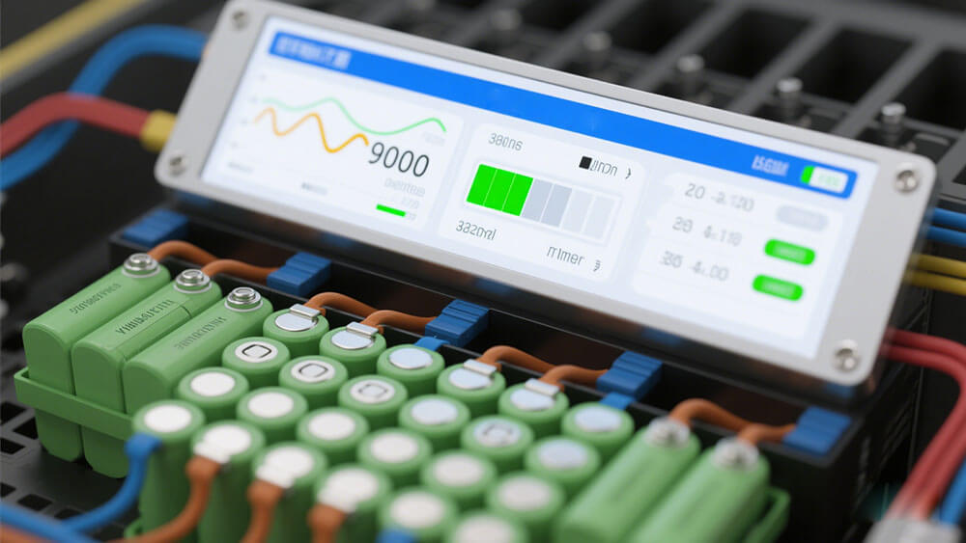
3.4 Fuel Gauge and State of Charge
A battery fuel gauge informs the user how much power is left relative to the battery's total capacity. The cost and complexity of a fuel gauge vary depending on the required accuracy.
For applications that do not require high precision, a simple voltage-based lookup gauge may only add 10% to the pack's cost. However, for applications requiring high accuracy, a sophisticated coulomb-counting or impedance-tracking fuel gauge could potentially double the cost of a small multi-cell battery. The good news is that the value received from an accurate fuel gauge often far outweighs the additional cost.
What is a Battery Fuel Gauge?
Unlike the fuel gauge in a car, where the tank size is constant, a battery's capacity (its "tank size") is constantly changing with temperature, age, and the rate of energy consumption. To accurately calculate the remaining capacity, all of these variables must be accounted for.
Primary Fuel Gauging Methods:
Voltage Lookup
The state of charge is estimated by measuring the battery's voltage and comparing it to an internal lookup table. This is the least accurate method.
Coulomb Counting
The total amount of energy entering and leaving the battery is precisely measured. This is more accurate but can drift over time.
Combination Method Uses both voltage lookup
and coulomb counting, with each method correcting for the inaccuracies of the other.
Power Differently

Slide 22
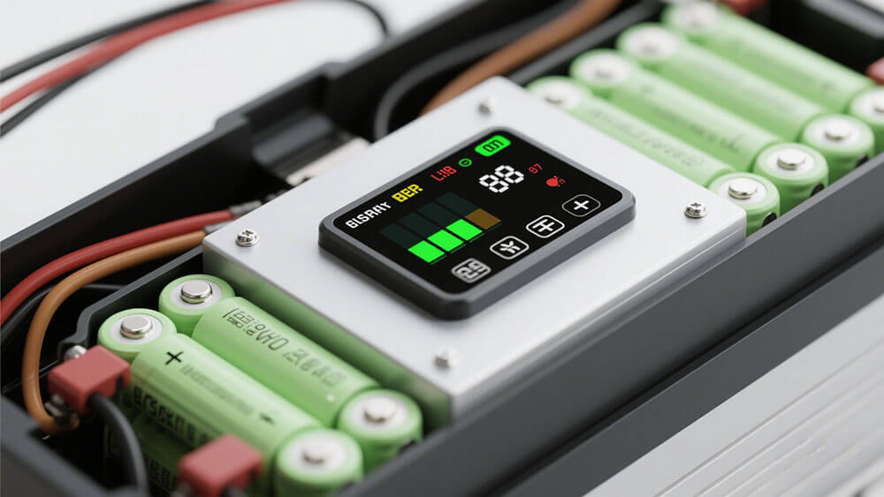
3.5 Advanced GPIO Options
General Purpose Input/Outputs (GPIO) can be added to nearly any custom battery pack, providing a simple two-wire interface (like I2C) to control battery subsystems or even functions of the end product itself.
GPIO is particularly useful when a system needs additional logic that wasn't originally designed into the main product, or when a single battery pack needs to support multiple product SKUs with different requirements. For example, if different products require different regulated voltages, GPIO can be used to adjust the battery's output regulator based on software commands from each system. This allows one battery pack to intelligently power many different products.
Examples of GPIO Options:
Adjust battery charger current Turn LED indicators on and off
Read internal hardware status indicators
Activate or switch between multiple battery banks Adjust on-board voltage regulators
Initiate self-destruct protocols to protect intellectual property (for military applications)
Power Differently

Slide 23
4
Section 4
Power System and Charging Design
All lithium-ion batteries require a BMS because they can fail if overcharged, fully discharged, or operated outside their safe temperature window. For complex systems, the BMS is essential for protecting expensive components and adding critical functionality including UPS capabilities, power boosting, and fluctuation control.
  Integrated System Output Power
Cell, module, and battery architecture with system-level power management and UPS functionality.
  Battery Charging Methodologies
Constant Current (CC), Constant Voltage (CV), CC-CV, and pulsed charging with custom charger design options.
Power Differently

Slide 24
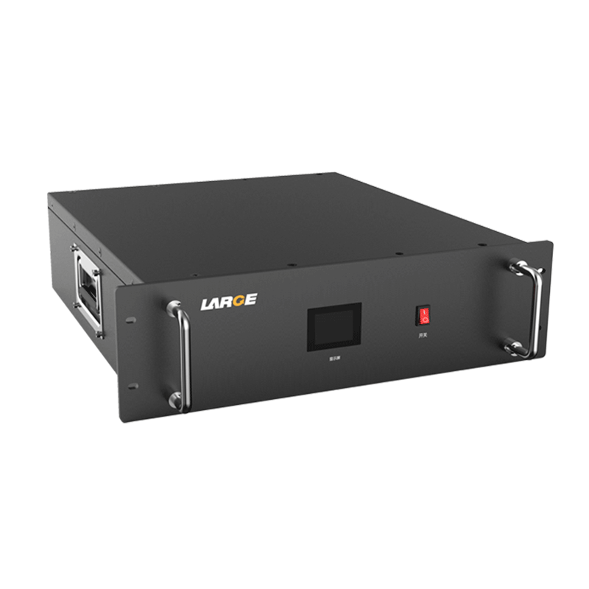
4.1 Integrated System Output Power
A Battery Management System (BMS) is essential for all lithium-ion batteries as they can fail if overcharged, fully discharged, or operated outside their safe temperature window. For complex systems, the BMS is crucial for protecting expensive components and adding critical functionality.
Difference Between a Cell, Module, and Pack
Battery Cell: The basic electrochemical unit
Battery Module: A group of cells connected in series or parallel, typically managed by a Module Control Unit (MCU)
Battery Pack: The complete, assembled pack, which may consist of several modules connected to a supervisory Battery Control Unit (BCU)
The BCU uses input from the MCUs to manage the entire pack, calculate historical values, and protect the system.
Optional System Output Power Design
Large Power can add custom circuitry to your battery pack's BMS to make it behave more like a power supply or an uninterruptible power supply (UPS) system. This is useful in applications that:
Need instantaneous UPS power in the event of input power failure
Need more power than the input source can provide (power boosting) Are sensitive to power fluctuations and require stable power delivery
This system design allows for both charging the battery and powering the device
Power Differently

Slide 25
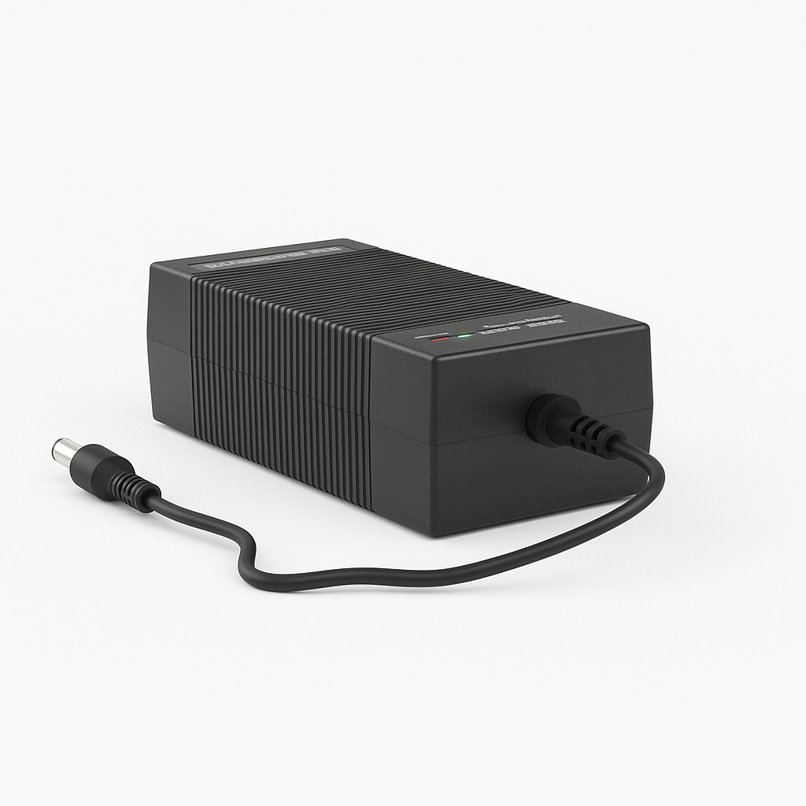
4.2 Battery Charging Methodologies
To provide a full power management solution, Large Power has the expertise to develop and configure battery chargers perfectly matched to your custom battery pack. Proper charging is essential for safe and optimal operation of any portable device.
Common Charging Methods:
Constant Voltage (CV)
Used for lead-acid and lithium-ion cells. Maintains a constant voltage with current tapering off as battery charges. Li-ion chargers require very tight voltage tolerance.
Constant Current (CC)
Used for NiCd and NiMH batteries. Maintains a constant current and switches off when battery's voltage reaches a specific level.
CC-CV Charging
Standard method for lithium-ion batteries. Battery charged at constant current until max voltage, then switches to constant voltage to safely top off.
Pulsed Charge
Charge current delivered in pulses with rest periods between. Allows battery chemistry to stabilize, potentially improving cycle life.
Warning: Trickle Charging
A very low-rate charge designed to compensate for self-discharge. This is not suitable for lithium chemistries, which can be damaged by overcharging.
Custom Charger Design Options:
External Charger: Stand-alone unit where battery is removed from product (common for power tools)
External Power Supply: AC/DC adapter plugs into product with internal charging circuitry (common for laptops)
Embedded Charger: Charging circuitry fully integrated into the battery pack itself
Security Integration: Synched battery pack & charger encryption for enhanced security and validation
Power Differently

Slide 26

5
Section 5
Mechanical and Environmental Design
A well-designed battery pack enclosure provides essential mechanical protection, thermal management, and safety for the end user. The electrical interconnections, mechanical supports, external casing, and thermodynamic systems are all critical elements of the pack's structural design.
  Enclosure and Mechanical Specifications
Various enclosure types from shrink wrap to injection molded designs, mechanical protection systems, and thermal considerations.
  Intrinsically Safe & Explosion-Proof Designs
Specialized designs for hazardous environments with certifications to Ex ia/ib IIA/IIB standards.
IP Rating & Environmental Protection
Ingress Protection ratings and design features to meet specific environmental challenges.
Power Differently

Slide 27

5.1 Enclosure and Mechanical Specifications
A well-designed battery pack enclosure provides essential mechanical protection, thermal management, and safety for the end user. The electrical interconnections, mechanical supports, external casing, and thermodynamic systems are all critical elements of the pack's structural design.
Enclosure Types:
Shrink Wrap or Vacuum Formed Plastic: The simplest and least expensive option, suitable only if the battery is fully enclosed within the finished product.
Injection Molded Plastic: The most common type of enclosure. Two or more plastic parts are molded and then assembled around the pack and circuitry. They can be sealed using glue, mechanical fasteners, or ultrasonic welding.
For high-volume applications, insert molding can be used to mold interconnection strips and terminals directly into the plastic, reducing material and assembly costs.
In many designs, the battery pack forms part of the outer case of the end product, requiring high-precision molding and tight tolerances to interface correctly with the device and any latching mechanisms.
Other Considerations:
Thermal Management: Enclosures must account for thermal effects and may require vent holes to dissipate heat or exhaust vented gases.
Tolerances must also allow for potential cell swelling over the battery's lifetime (some Lithium pouch cells can swell up to 10%).
IP Rating: The Ingress Protection (IP) rating defines how resistant the enclosure is to dust and water. Large Power can design enclosures to meet specific IP ratings required by different industries.
Potting and Encapsulation: For applications requiring extreme durability or protection from
Power Differently

Slide 28
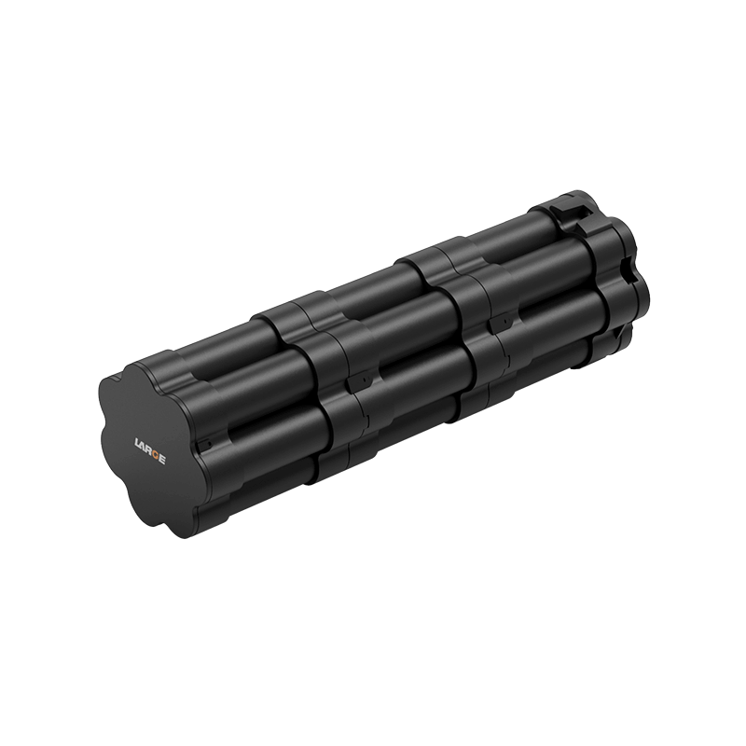
5.2 Intrinsically Safe & Explosion-Proof Designs
For applications in hazardous environments (e.g., mining, oil & gas, chemical facilities) containing explosive gases or dust, Large Power designs intrinsically safe and explosion- proof batteries.
These specialized designs use specific enclosure materials and potting compounds to eliminate air gaps and ensure the battery cannot initiate an explosion, even if the device malfunctions.
Key Design Considerations:
Material selection for hazardous/explosive environments Potting and encapsulation to eliminate all air gaps Enhanced thermal management systems
Certified to Ex ia/ib IIA/IIB standards Zero-gap protection mechanisms
Large Power has extensive experience certifying batteries to Ex ia/ib IIA/IIB standards for the most demanding hazardous location applications.
Power Differently

Slide 29
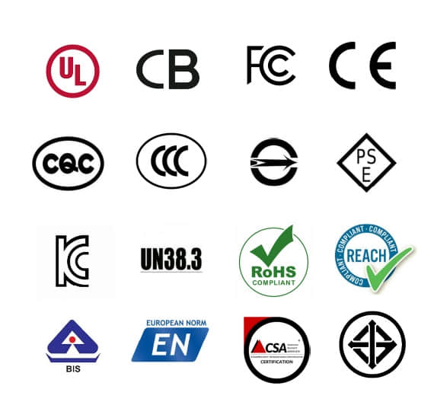
6
Section 6
Regulatory Compliance and Logistics
Ensuring lithium battery safety is the highest priority for any manufacturer. Product safety certifications from independent bodies like UL and IEC are a universal standard for leading electronics companies. Large Power has years of experience managing the entire certification process, leveraging our in-house resources and relationships with testing agencies to ensure your product meets all necessary safety standards.
  Navigating Global Certifications (UL, IEC, CE)
Comprehensive guidance on safety standards, cost estimates, and certification timelines.
  UN 38.3 Transportation Testing
Required tests (T.1-T.8) simulating transport hazards for international battery shipment.
  Shipping and Transportation Logistics
Navigating complex regulations for lithium battery transport by air, sea, and land.
Power Differently

Slide 30
6.1 Navigating Global Certifications
Ensuring lithium battery safety is the highest priority for any manufacturer. Product safety certifications from independent bodies like UL and IEC are a universal standard for leading electronics companies. Large Power has years of experience managing the entire certification process, leveraging our in-house resources and relationships with testing agencies to ensure your product meets all necessary safety standards.
The costs and lead times for these tests vary depending on the battery's construction, capacity, and chemistry. We will provide specific estimates for your design in our initial proposal.
Certification
Description Est. Cost
Test Timing
UN 38.3 | Required for shipping ANY lithium battery by air. Focuses on transportation safety. | $1,000 - $2,000 | 3-4 weeks
IEC 62133 | International safety standard for portable sealed secondary cells. | $2,000 - $5,000 | 5-6 weeks
UL 2054 / 1642 | Leading US safety standards for battery packs and cells. | $7,000 - $20,000 | 6-8 weeks
CE Marking | Self-declaration for products sold in the European Union. | ~$500 | 3 weeks
ISO 13485 | Quality management system standard for medical devices. | Varies | Varies
Explosion- Proof | For hazardous environments (e.g., Ex ia/ib IIA/IIB). | Varies | Varies
UN/DOT 38.3: This is the most fundamental certification, as it is required to transport lithium batteries by air. It consists of eight tests (T1-T8) focused on simulating the hazards of transportation.
IATA: The International Air Transport Association provides guidance on shipping regulations. Any
Power Differently

Slide 31

6.2 UN 38.3 Transportation Testing
The UN "Recommendations on the Transport Of Dangerous Goods Manual of Tests and Criteria" is the internationally recognized authority for testing dangerous goods. Large Power ensures all new battery designs are certified against this standard to weather the rigors of transport.
The UN 38.3 tests include:
  Altitude: Simulates air transport under low pressure.
  Thermal: Assesses seal integrity with rapid and extreme temperature changes.
  Vibration: Simulates vibration during transport.
  Shock: Simulates possible impacts during transport.
  External Short Circuit: Simulates an external short circuit.
  Impact: Simulates an impact (for cells only).
  Overcharge: Evaluates a rechargeable battery's ability to withstand an overcharging.
  Forced Discharge: Evaluates a cell's ability to withstand a forced discharge condition.
Logistics Management:
Lithium batteries are classified as hazardous materials and are subject to strict transportation regulations. International shipments are regulated by the ICAO Technical Instructions (for air) and the IMDG code (for sea). Shipments within the U.S. are regulated by Title 49 of the Code of Federal Regulations (49 CFR).
Large Power manages all aspects of logistics and transportation compliance, ensuring that from prototypes to mass production, your battery packs are packaged, labeled, and documented correctly to avoid delays and liability.
Power Differently

Slide 32
7
Section 7
Partnering with Large Power
Choosing the right battery partner is critical to the success of your product. Large Power offers a unique combination of specialization, expertise, and client-focused service that sets us apart. From core technology development to production of complete power systems.
1
Deep Specialization in Extreme Environments
We don't try to be everything to everyone. We focus exclusively on developing and manufacturing high-performance lithium batteries for specialized, demanding applications, ensuring unmatched performance under the most challenging conditions.
2
Fully Integrated "One-Stop" Customization
From core technology development and cell design to large-scale production of complete power systems, our fully integrated facilities allow for rapid iteration, strict quality control, and seamless scaling of innovative battery designs.
3
Technology-Driven Innovation
Our R&D efforts are guided by a team of highly experienced scientists and engineers, supported by collaborations with leading universities. This ensures every solution is grounded in cutting-edge science and market relevance.
4
Uncompromising Quality and Reliability
With rigorous quality control processes (ISO 9001, ISO 13485) and adherence to international certification standards (UL, IEC, UN 38.3), we deliver batteries that consistently and reliably meet the most stringent safety and performance requirements.
Contact Our Team Email: market@large-battery.com Website: www.large-battery.com
Power Differently

Slide 33
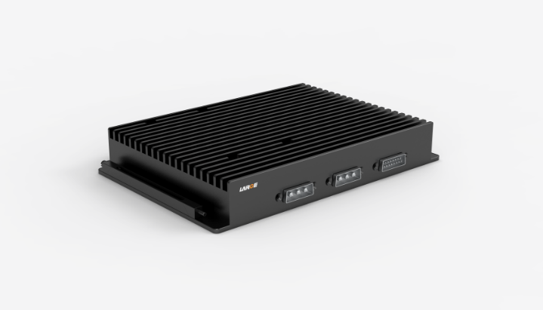
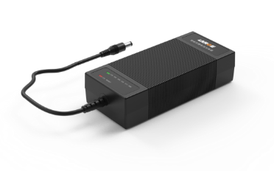
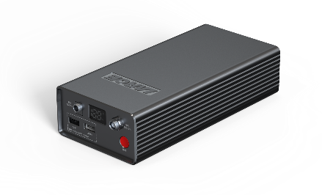
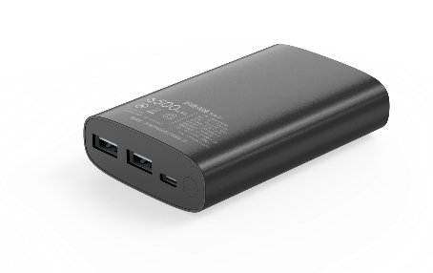
Appendix: Glossary of Terms
Anode: The negative electrode of a cell.
Capacity: The product of the discharge current (A) and discharge time (h), expressed in Amp-Hours (Ah).
Cathode: The positive electrode of a cell.
Nominal Voltage: The approximate midpoint voltage of a fully charged battery cell during discharge.
Open Circuit Voltage (OCV): The voltage across a battery's terminals when no current is flowing.
Cell: A single encased electrochemical unit (one positive Protection Circuit Module (PCM): ^{The safety circuit}
and one negative electrode).
Cycle: One sequence of fully charging and fully discharging a rechargeable battery.
Energy Density: Available energy of a battery per unit volume (Wh/L) or unit weight (Wh/kg).
IATA: The International Air Transport Association. Internal Impedance: The internal resistance of a cell, which increases as it ages or is discharged.
installed in lithium-ion battery packs to control over- charge, over-discharge, and short circuits.
Self-discharge: The decrease in capacity during storage without load, caused by internal chemical reactions.
SMBus: System Management Bus, a two-wire communication protocol used for system management. UN 38.3 Tests: A series of mandatory tests required to transport lithium batteries.
Vent: A safety device built into cells to release internal pressure in case of abuse.
Watt-hours (Wh): A measure of energy, calculated by multiplying a battery's nominal voltage by its rated capacity in amp-hours.
Power Differently
Power Differently

